Slide 1
Deployment of Web Application Using Azure DevOps CI/CD Pipeline
Presented By :
Maddirala Satya Sravani
Technologies Used :
Microsoft Azure
Azure DevOps
Azure Web App
CI/CD Pipelines

Slide 2
Introduction
This project demonstrates deployment of a web application using Microsoft Azure and Azure DevOps services.
Implementation includes :
Creating Azure Resource Group
Hosting using Azure Web App
Build Pipeline
Release Pipeline
Automated deployment using CI/CD

Slide 3
Technologies Used
• Microsoft Azure
• Azure Resource Group
• Azure Web App
• Azure DevOps
• Build Pipeline
• Release Pipeline
• Git Repository

Slide 4
Project Workflow
→ → →
→ →
Developer → Azure Repos → Build Pipeline → Release Pipeline → Azure Web App → User
Developer
Azure Repos
Build Pipeline
Release Pipeline
Azure Web App
User

Slide 5
Resource Group and Web App
A Resource Group is a logical container used to organize Azure resources.
Azure Web App is a cloud hosting service used to deploy and manage web applications.

Slide 6
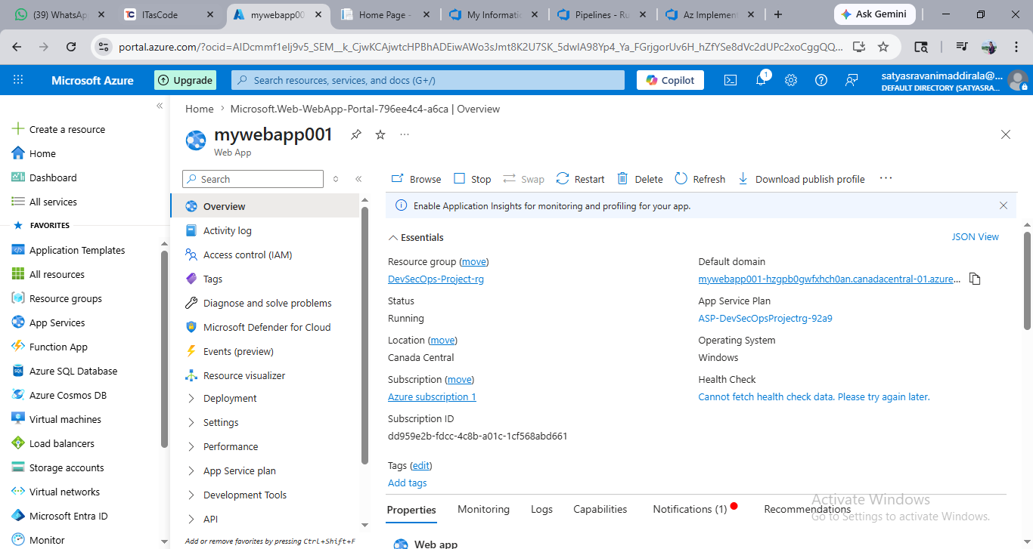
Azure Web App Overview
Azure Web App created successfully and configured for hosting.

Slide 7
Build Pipeline
The Build Pipeline automates :
Source code retrieval
Dependency installation
Code compilation
Artifact creation
Benefits :
Faster builds
Reduced manual work
Early error detection

Slide 8
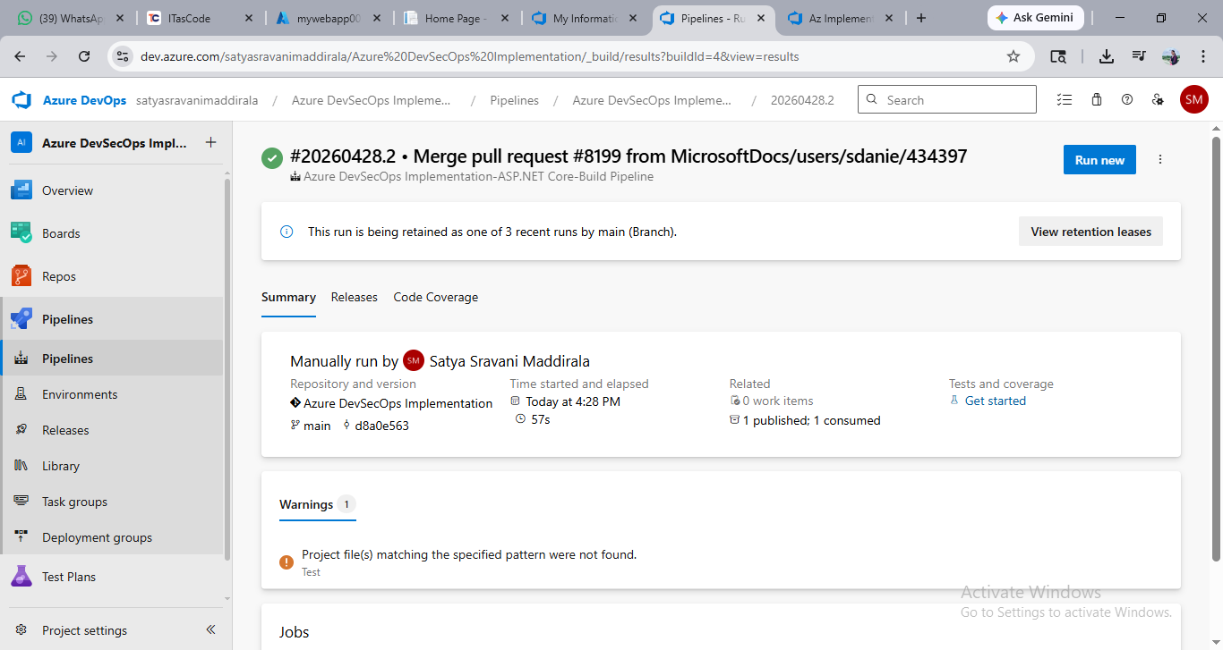
Build Pipeline Execution
Successful execution of Build Pipeline in Azure DevOps.

Slide 9
Release Pipeline
The Release Pipeline automates deployment of the application to Azure Web App.
Deployment Steps :
Retrieve build artifacts
Connect to Azure
Deploy application
Verify deployment

Slide 10
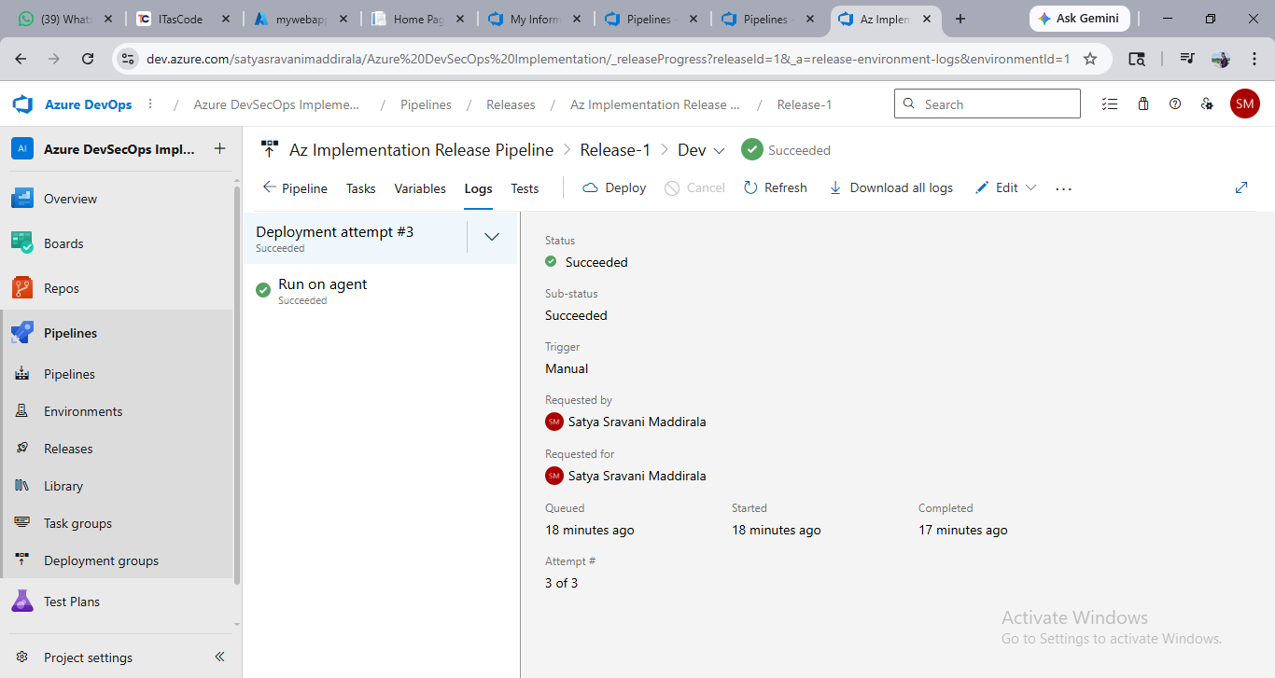
Release Pipeline Execution
Successful deployment using Release Pipeline.

Slide 11
CI/CD Process
Continuous Integration (CI):
Build pipeline automatically validates and builds code.
Continuous Deployment (CD):
Release pipeline automatically deploys latest build.
Advantages:
Automation
Faster delivery
Better productivity

Slide 12
Application Deployment Result
The application was successfully deployed and accessed through Azure Web App URL.
Deployment verified successfully through browser access.

Slide 13
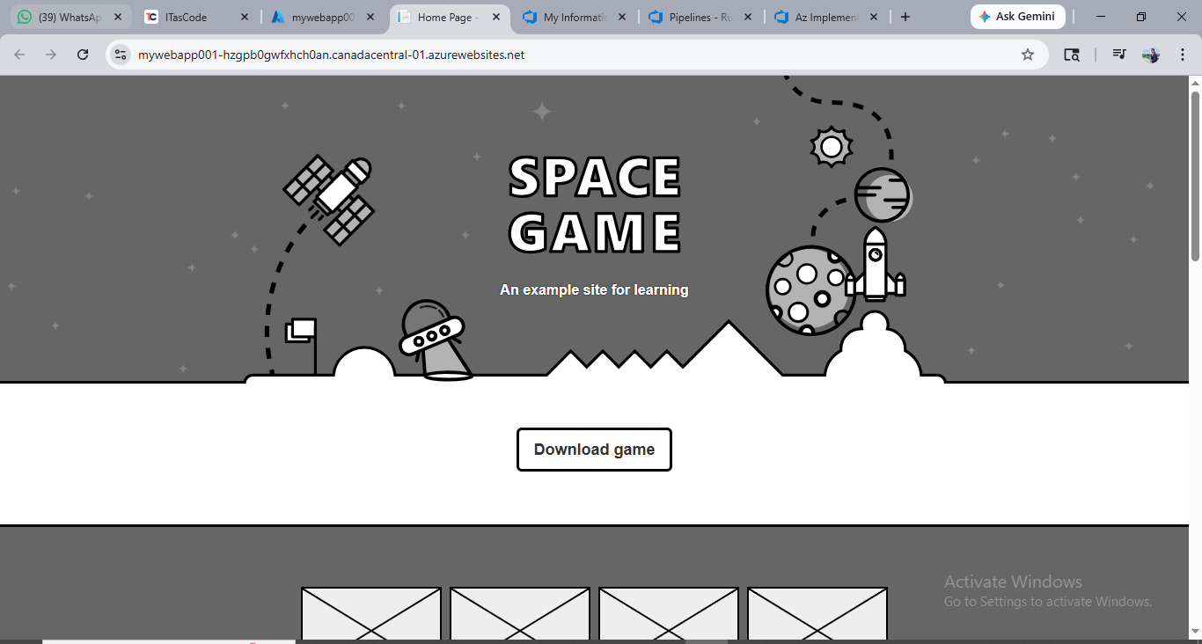
Deployed Application
Successfully deployed web application running online.

Slide 14
Conclusion
This project successfully demonstrated automated deployment using Azure DevOps CI/CD pipelines.
The application was hosted successfully on Azure Web App with automated deployment.

Slide 15


